Slide 1
The Lawgiver
Tyler Boyce
Notes:
Hello, my name is Tyler Boyce, and this is The Lawgiver.

Slide 2
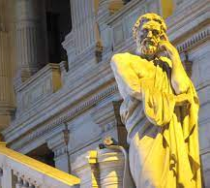
You play as a Spartan named Lycurgus.
As Lycurgus, Player travels around Ancient Mediterranean.
Player creates a new Sparta, using the knowledge they gain.
Notes:
In The Lawgiver, you play as a Spartan named Lycurgus. Traveling around the Ancient Mediterranean, you must learn the customs and knowledge of other cultures. Bring back what you have learned to your Greek homeland, to assemble your own Sparta.

Slide 3
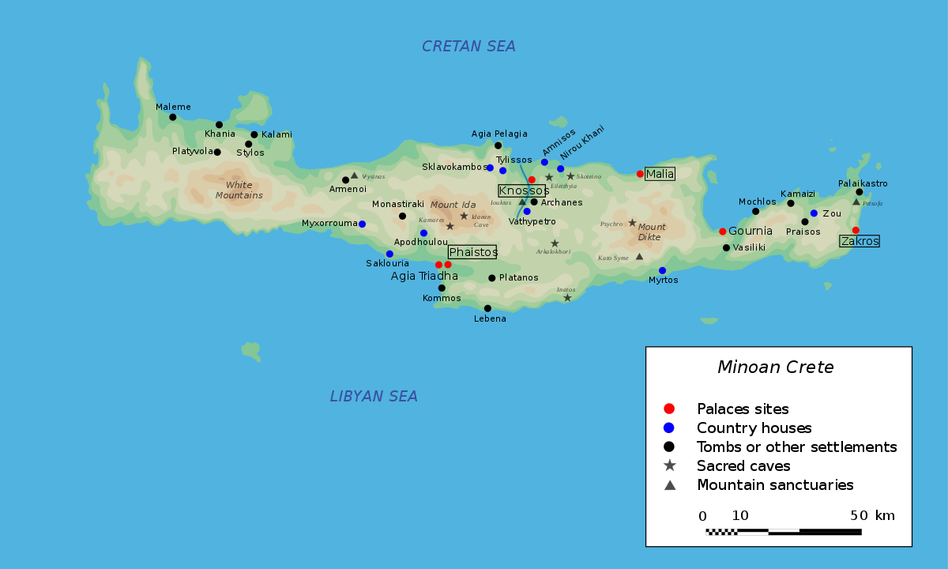
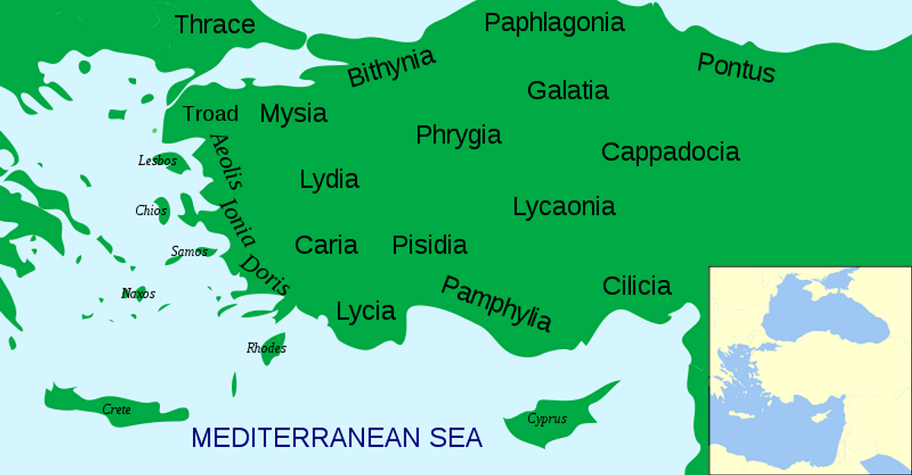
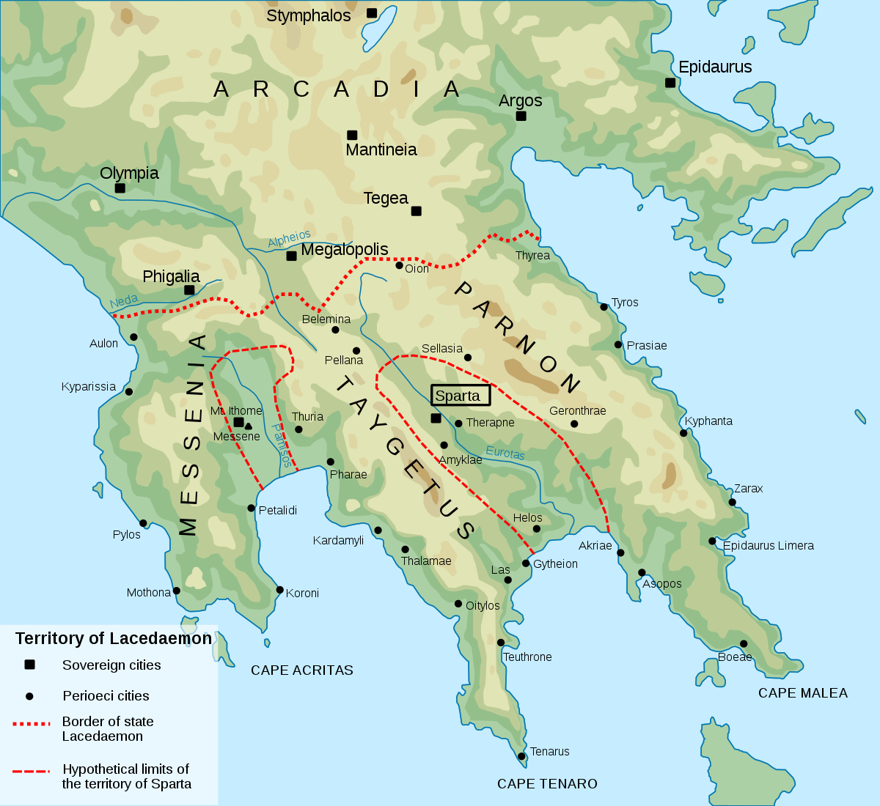
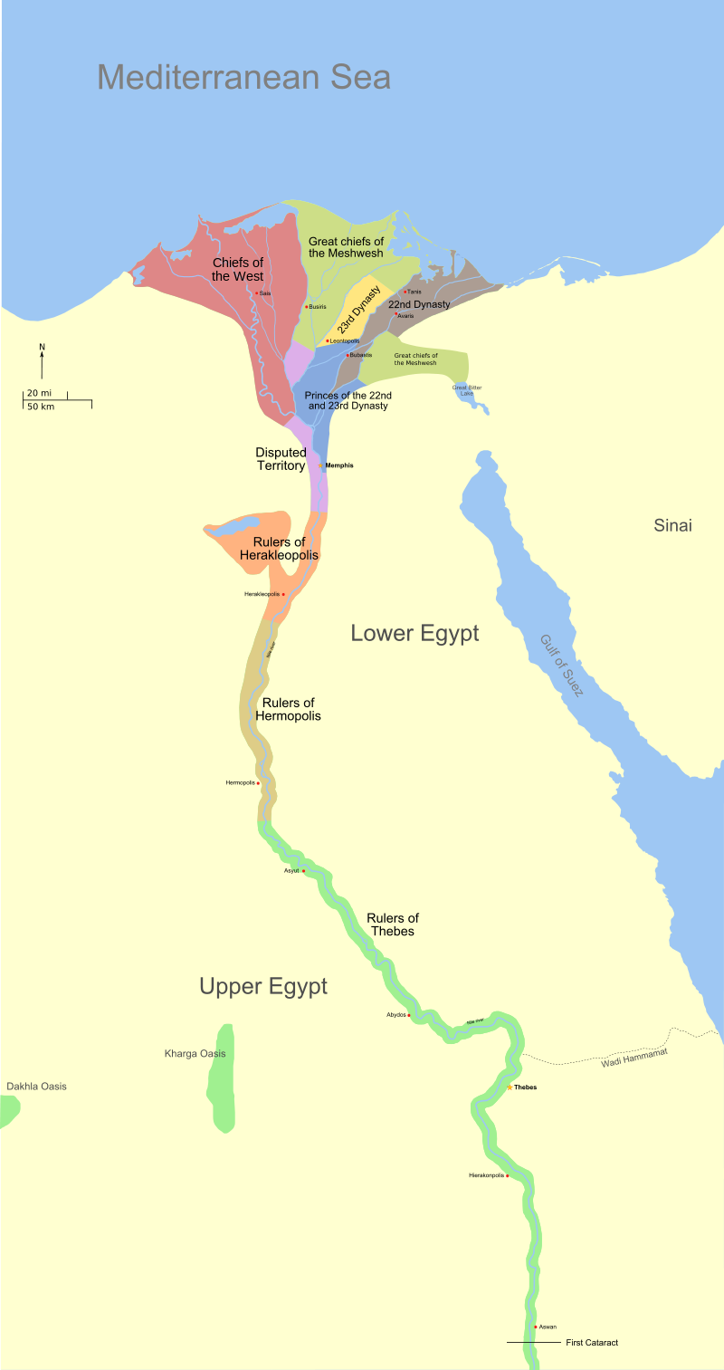
Game Concept
Crete
Asia Minor
The Lawgiver is a 2D isometric point-and-click adventure game.
made in Unity 2D
Player visits and studies the cultures of Crete, Asia Minor, and Egypt.
Sparta
Egypt
Notes:
The Lawgiver is a 2D isometric adventure game, with an art style like that of classic fantasy RPGs. The player will explore the lands and cultures of Crete, Asia Minor, and Egypt.

Slide 4
Core Gameplay
Notes:
Triangle?
The core gameplay loop is the player travels from Sparta to a new land, gather knowledge there, and once you have added as much knowledge as you can to your journal, you will take that into the endgame phase to craft the government and society of your Sparta.

Slide 5
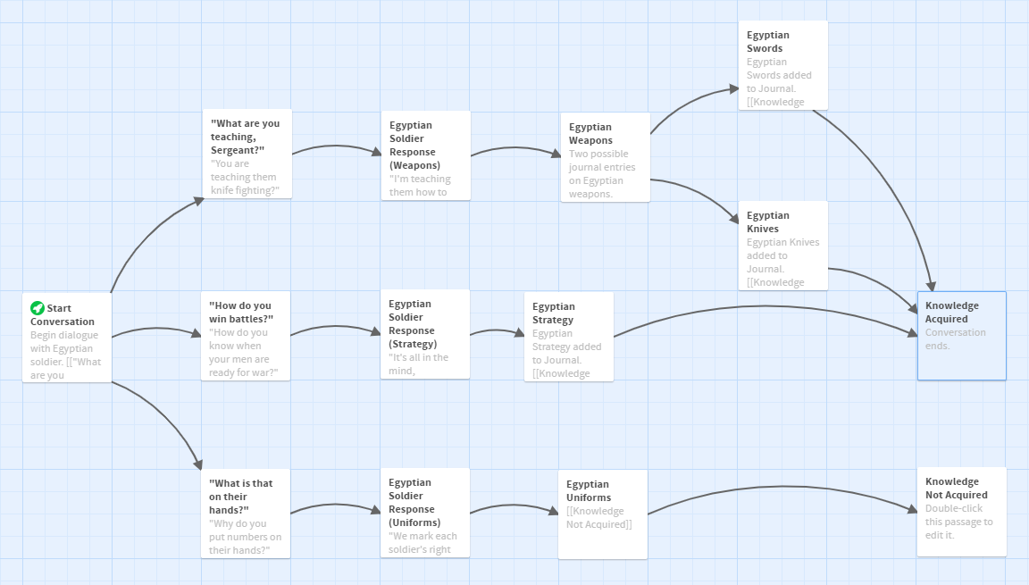
Gather Knowledge
Core Mechanics
Point-and-Click Exploration (like Telltale’s The Walking Dead)
NPC Dialogue (only converse once with each)
Coin System (time restraints on Player)
Notes:
For the first node of this loop, you gather knowledge through two mechanics. You can point-and-click on objects and the environment (like the King’s Quest games or Telltale Games) to gain a journal entry. Or you can converse with NPCs through branching dialogue. You can only get one piece of information from each NPC, so think carefully when choosing the topic of your conversation. Lycurgus can also use coins to acquire knowledge. Be warned: Lycurgus only has a limited amount of money while traveling. Once you’re out of coins, you must go back to Sparta with what knowledge you have.

Slide 6
Add entries to Lycurgus’s journal:
Types of Knowledge:
Customs
Fashion
Currency
Architecture
Food
Homer’s Epics
“With it or on it!”
words given by Spartan mothers and wives to departing soldiers
Farming and mining are the trades of the enslaved helots. A Spartan citizen has only one profession: war…
Notes:
Knowledge is then acquired by Lycurgus in the form of journal entries. Journal entries cover a broad range of topics, from fashion to food to even local mythology. I used the Codex mechanic from Dragon Age: Origins as inspiration for this journal, with a mockup of my concept on the right.

Slide 7
Game Finale
Find similarities in your journal to create concepts.
In the game finale, design your Sparta.
Monarchy vs. Democracy?
Civil Rights?
Militarism or Pacifism?
Multiple Epilogues
How successful is your Sparta?
Are your people happy?
Notes:
Once you have acquired the maximum attainable knowledge from all areas, you bring that corpus of knowledge back to Sparta for the finale. Create political or cultural concepts using one or more journal entries, and then use those concepts to craft your Sparta. There are multiple possible epilogues, each detailing how successful your city becomes and how content your citizens are with your reforms.

Slide 8
Team Roles and Development Roadmap
Pre-Production
Vertical Slice
Production
Researching and Writing journal entries
Early-stage Historical Research
Character Controller
UI Design
NPC Dialogue
Area/Level Design
Finale System Prototype
Writing Multiple Endings
1 Creative Director
1 Producer
2 Programmers
2 Animators
2 Artists (for background and characters)
1 Audio Designer
1 Narrative Designer
Notes:
These are the roles required for our game. (pause for effect) We have also mapped out our development schedule, with all the tasks required for both pre-production and production. (pause for effect)

Slide 9
Key Goals and Stretch Goals
Key Goals
Stretch Goals
December 22, 2021: first playable (proof-of-concept) prototype
Egypt as a testing ground
10 possible pieces of information (enough Coins for 5)
2-3 epilogues
February 26, 2022: final game version
Crete, Asia Minor, and Egypt
30 possible pieces of information (enough Coins for 15)
5-7 epilogues
additional areas (Spain and India)
additional information in available areas
partial voice-over
Notes:
Create a parking lot slide detailing the year, and example of the Egypt setting, and the bullet points 2-3 NPCs and 4-5 interactive objects.
These are rough estimates of our key goals. We want to have our first playable prototype by December 22, 2021, using the Egypt area as a testbed. We’ll start with about 2-3 epilogues for that prototype. For the final game version, we are aiming for release by February 26, 2022. In addition to having all three areas, the game will be expanded to as many as 5-7 epilogues. A few stretch goals includes additional areas (such as Celtic Spain and even Vedic India), additional information in all areas, and (something very near and dear to my heart) partial voice-over of Lycurgus and the NPCs.

Slide 10
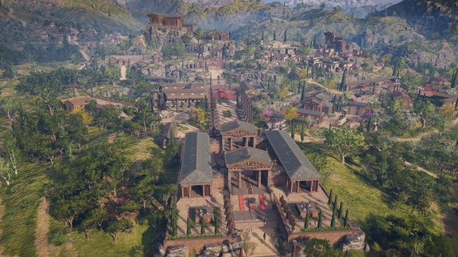
The Lawgiver “But you, when you come to Sparta, do not become worse, but better.” – King Eudamidas
Thank You! Questions or comments?
Notes:
The Lawgiver: “But you, when you come to Sparta, do not become worse, but better.” Thank you, and I will take your questions or comments.

Slide 11
Core Gameplay (graphic courtesy of Yuuki Min)

Slide 12
Travel
The journey of Lycurgus is just as much about rediscovery as discovery.
By the time of Lycurgus in 9th century BCE, Greece has only just reestablished cultural and trade links with eastern powers.
Random Encounters
Pirates
Storms

Slide 13
Sample of Branching Dialogue
“Ah, you are the Lacedaemonian from across the sea? What brings you to our city?”
“Who leads your people?”
(unlocks Government dialogue tree)
“What does your city make?”
(unlocks Trade dialogue tree)
“Do all your people dress this way?”
(unlocks Fashion dialogue tree)
Notes:
Bold dialogue choices, color code by knowledge type

Slide 14
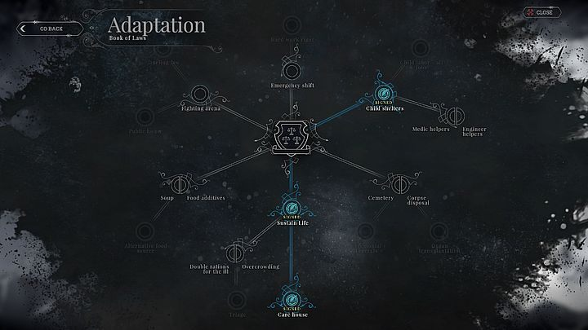
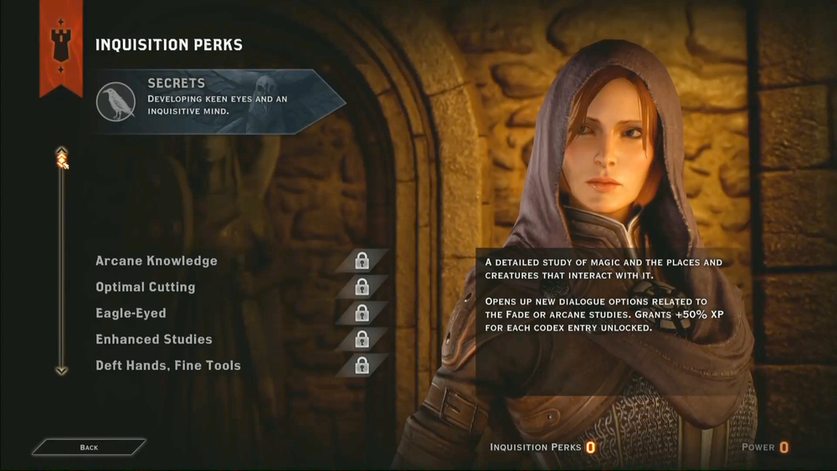
Game Finale Ideas
Idea A: Command Structure Configuration
Idea B: Book of Laws
Idea C: Advisor Perks
Notes:
Civilization 6: Choose a government, and then place policy cards into the afforded slots.
Frostpunk: Rules and directions grow out of two skill trees.
Dragon Age Inquisition: Advisors may not always disagree, but player can always count on their expertise.

Slide 15
Sample Ending
“Your reforms are institutional in Sparta’s rise to power.
By establishing the council, the government has stabilized.
The people and the rulers respect each other.
You have separated the military from workers and craftsmen to create a standing army.
The citizens give their complete and undivided allegiance to Sparta.
Your actions have ensured that the memory of your city and its virtues will endure for thousands of years to come.”
Player acquired Laws of Minos in Crete.
Player acquired Division of Labor from Egypt.
Notes:
Change “ending” to “epilogue” on all slides.

Slide 16
Historical Research
Books/Journals
“Life of Lycurgus”, Lives of the Noble Greeks and Romans by Plutarch (2nd century CE)
Ideal Commonwealths: Plutarch’s Lycurgus…, 4th ed. by Henry Morley (1889)
A History of Sparta 950-192 B.C. by W.G. Forrest (1969)
Academic Sources
UCSC Classics Department
Prof. John F. Bowin (philosophy)
University of Chicago Department of History
Prof. Jonathan M. Hall (history)
Notes:
Add 1-2 academic/professorial sources and 1-2 prominent and RECENT books. Also add Plutach’s Parallel Lives as a third source.

Slide 17
The year is 820 BCE.
Each area contains roughly:
2-3 NPCs
4-5 interactive objects
Notes:
Create a parking lot slide detailing the year, and example of the Egypt setting, and the bullet points 2-3 NPCs and 4-5 interactive objects.

